Slide 1
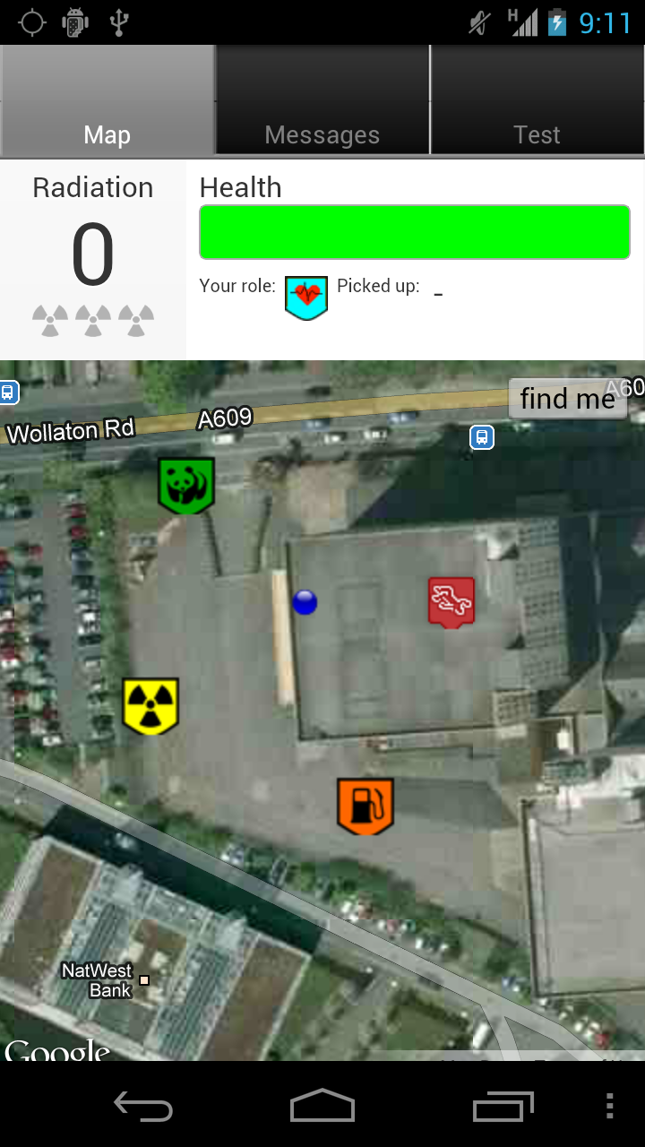
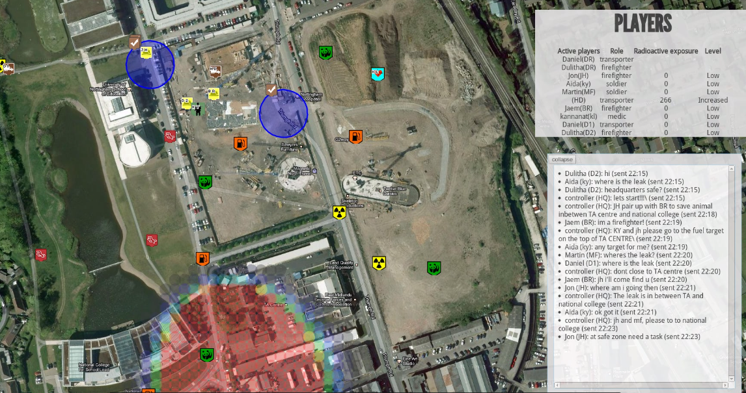
Messaging interface
currently missing
Mobile interface,
used by 6-8 responders
HQ interface,
used by 2-3 HQ players
HQ interface,
used by 2-3 HQ players

Slide 3
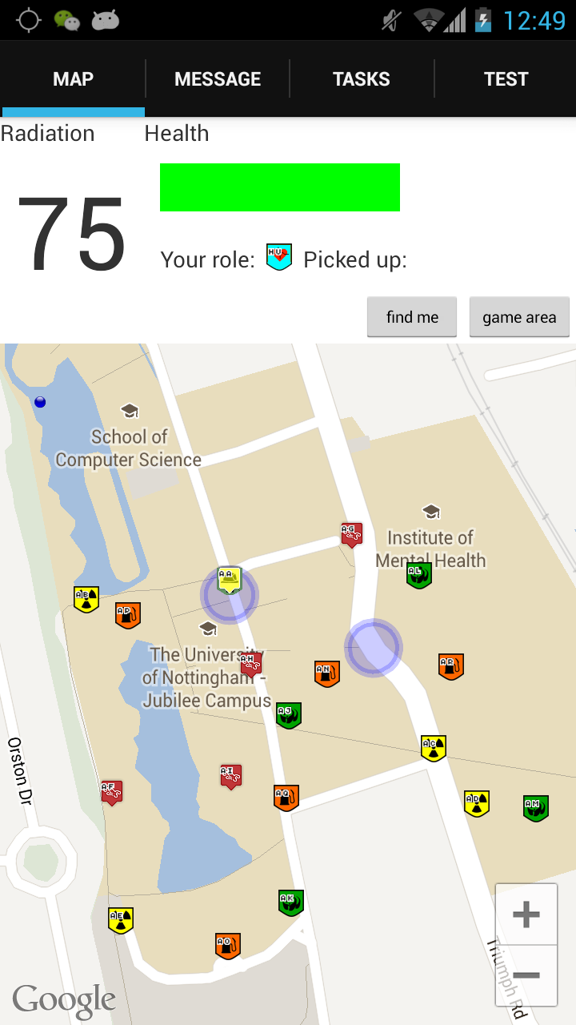
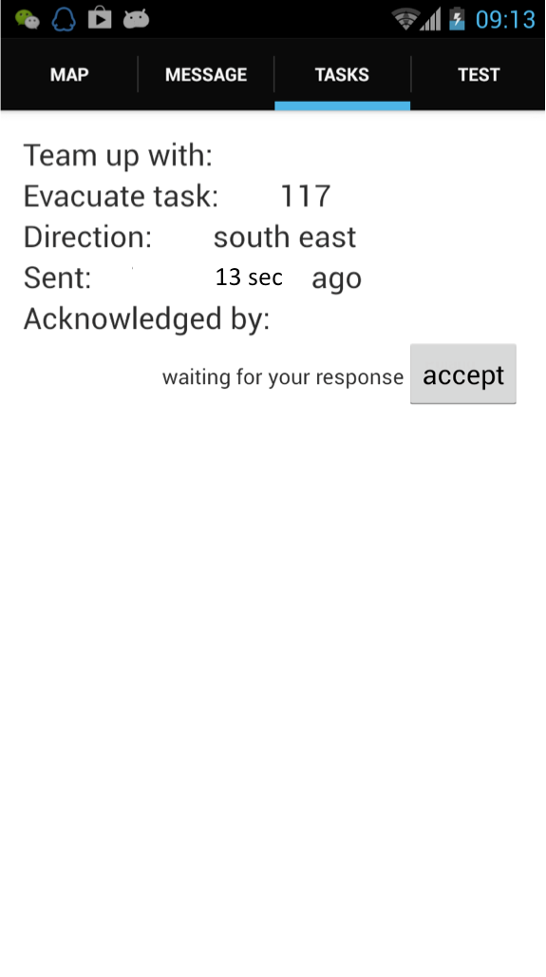
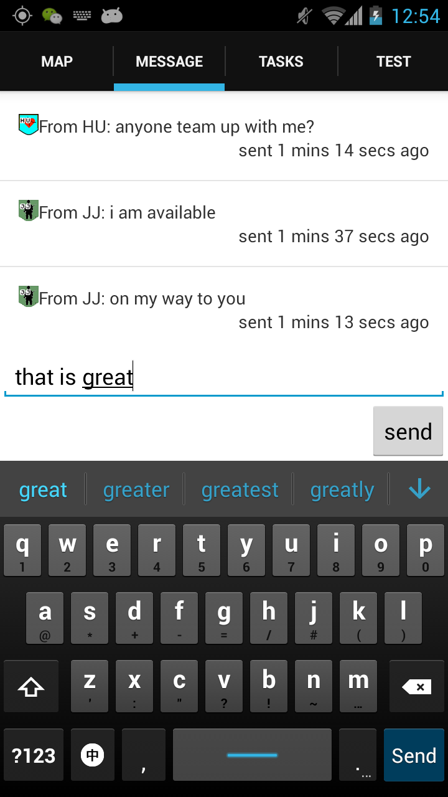
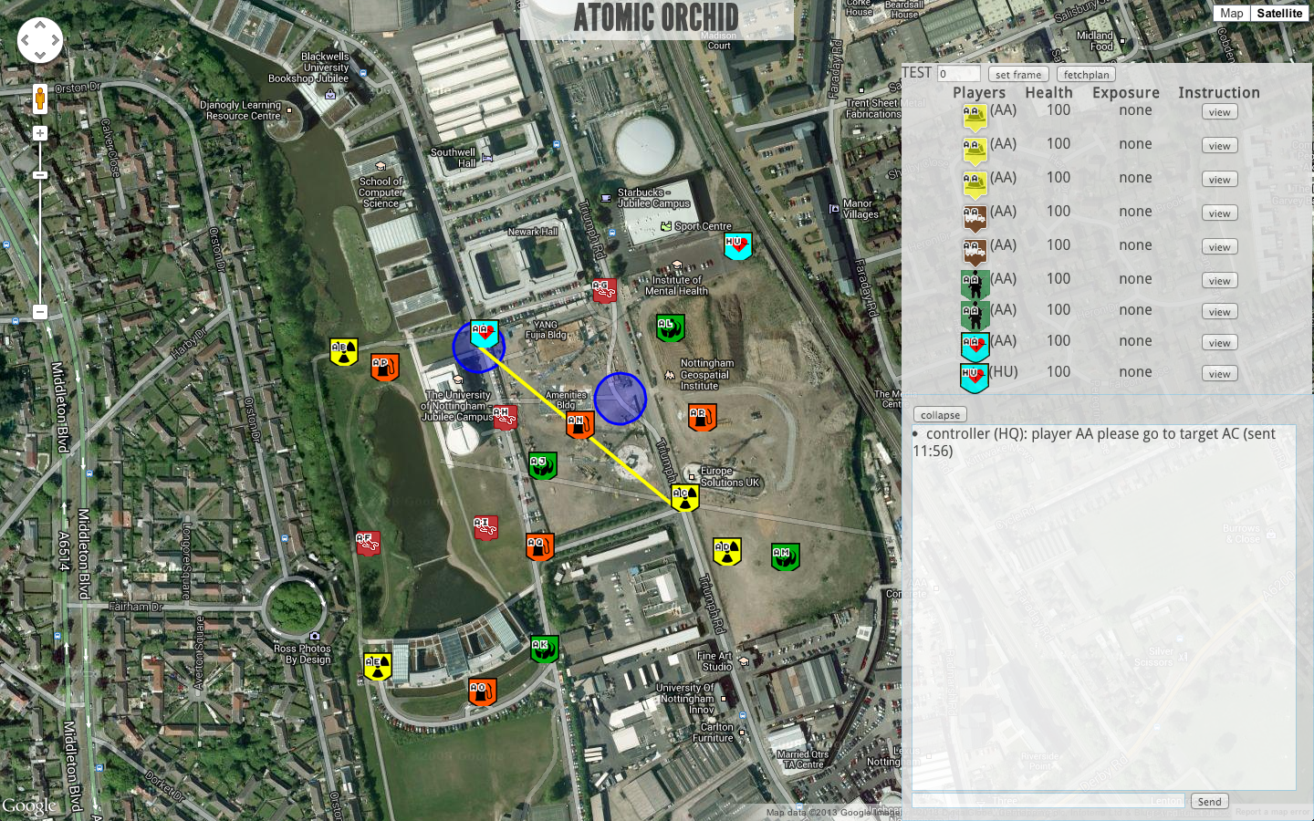
Mobile interface,
used by 8 responders
HQ interface,
Manned by 1 HQ player

Slide 4
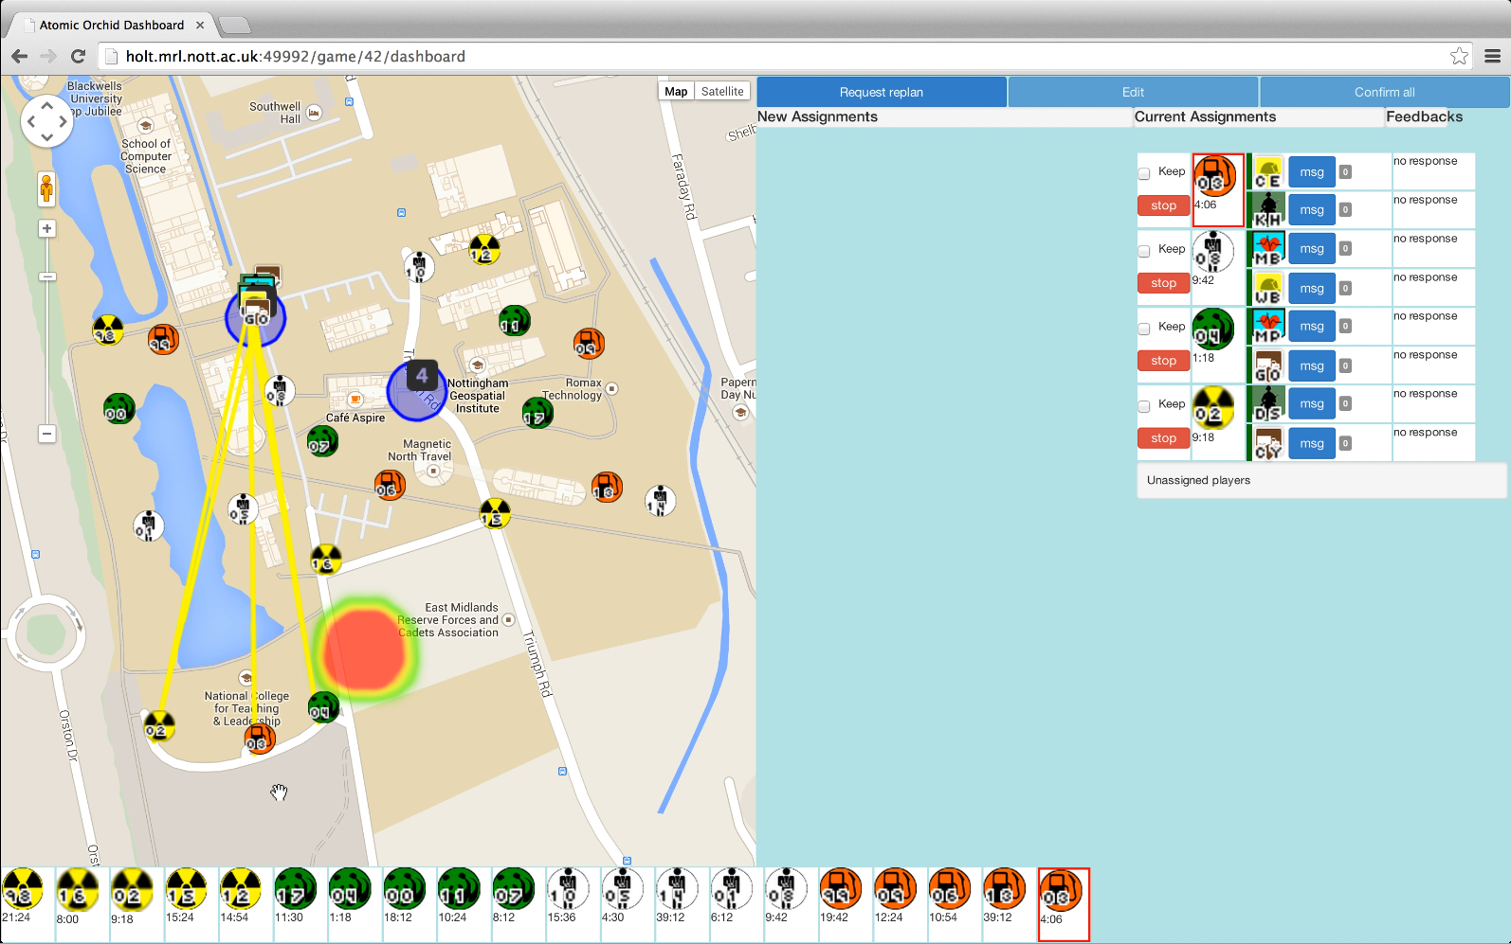
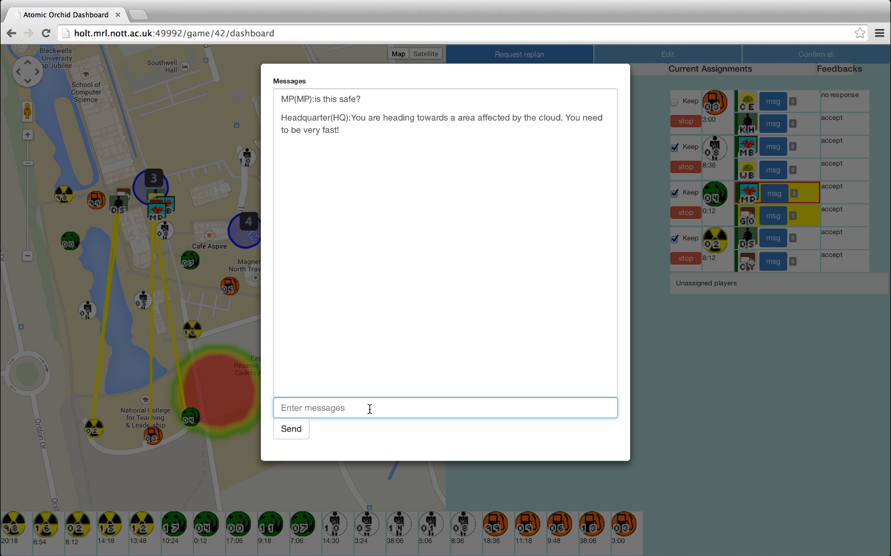
HQ interface 1, manned by 1 HQ player.
Left: task assignment
Right: messaging
HQ interface 2, manned by 1 HQ player

Slide 5
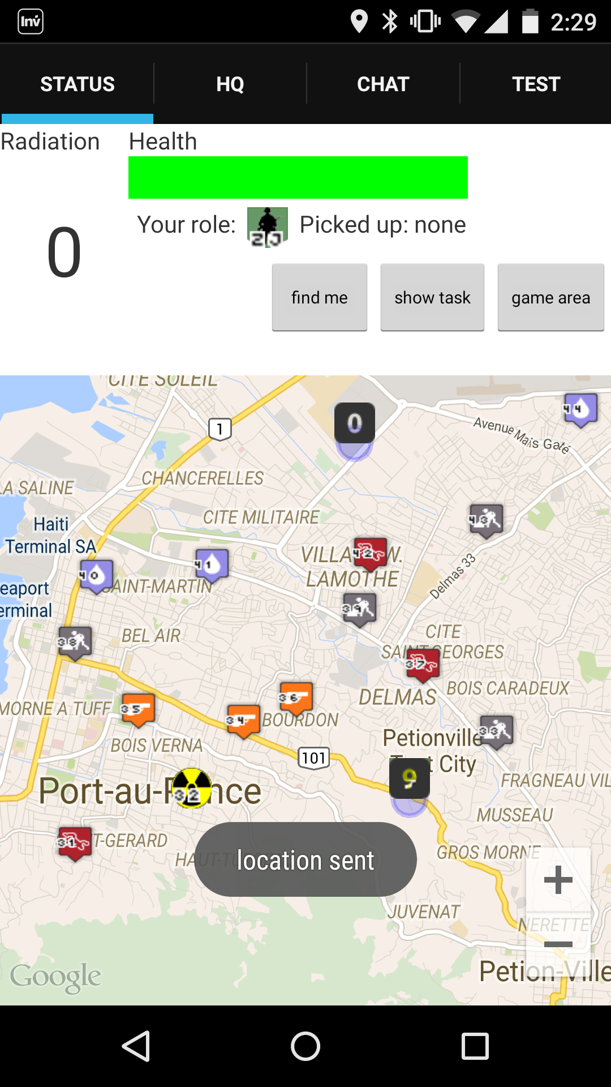
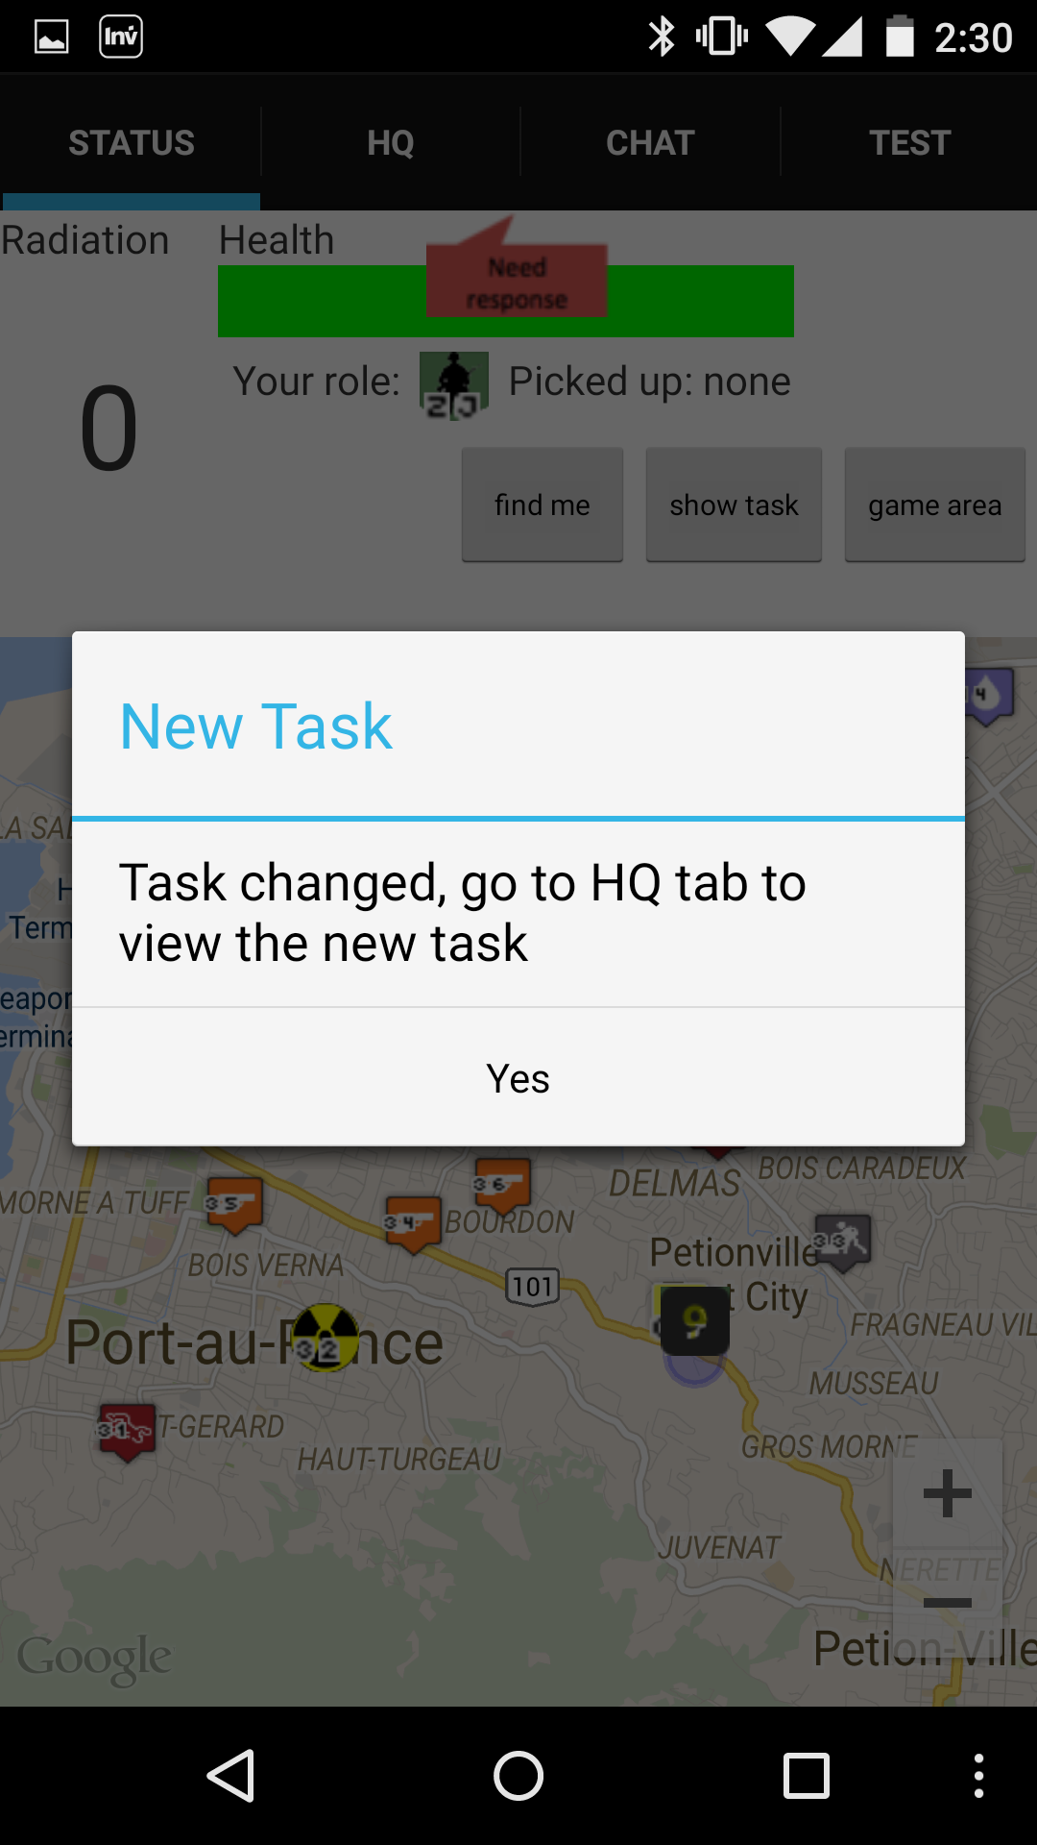
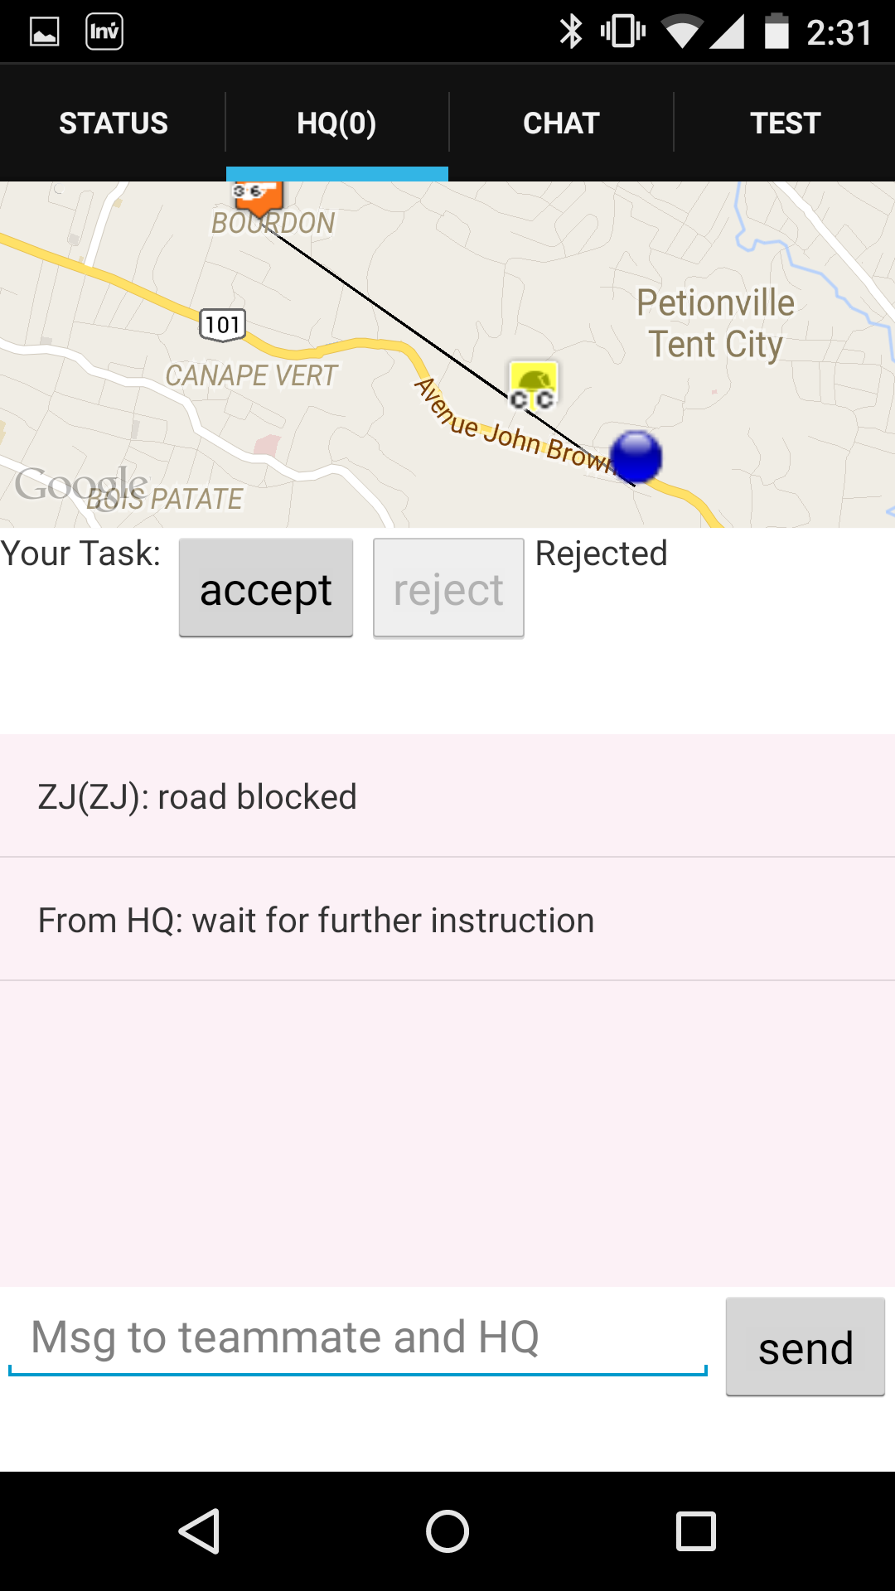
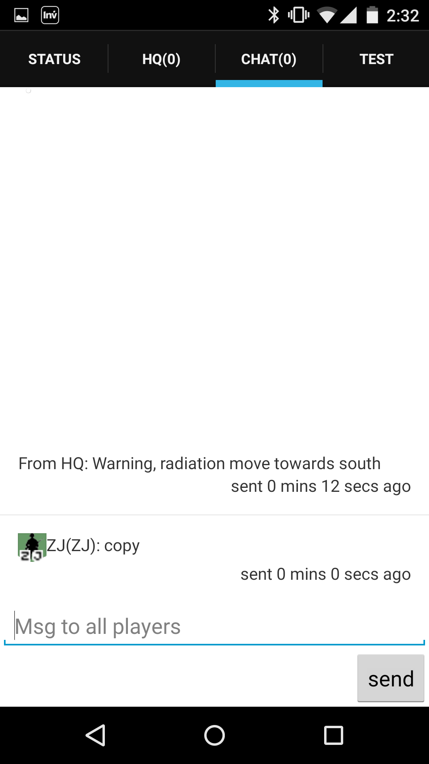
Mobile interface,
used by 8 field responders

